Slide 1
Session 26 (Black Board)
Introduction to Software Testing

Slide 2
Test is a process, to evaluate the functionality of a software application
Intent to find whether the developed software met the specified requirements or not and
Identify the defects to ensure that the product is defect free in order to produce the quality product.
A test case in software engineering is a set of conditions or variables under which a tester will determine whether an application or software system is working correctly or not.

Slide 3
What is a Test Suite?
Test suite is a container that has a set of tests which helps testers in executing and reporting the test execution status. It can take any of the three states namely Active, Inprogress and completed.
A Test case can be added to multiple test suites and test plans. After creating a test plan, test suites are created which in turn can have any number of tests.
Test suites are created based on the cycle or based on the scope. It can contain any type of tests, viz - functional or Non-Functional.

Slide 4
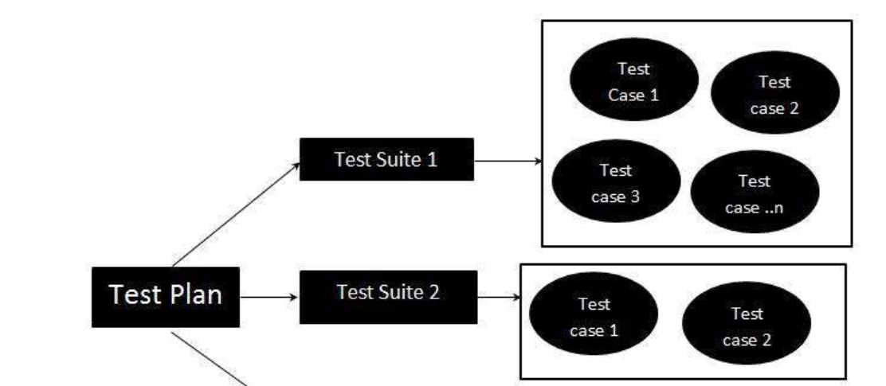
Diagram for Test suite

Slide 5
Software Validation
Validation is process of examining whether or not the software satisfies the user requirements. It is carried out at the end of the SDLC. If the software matches requirements for which it was made, it is validated.
Validation ensures the product under development is as per the user requirements.
Validation answers the question – "Are we developing the product which attempts all that user needs from this software ?".
Validation emphasizes on user requirements.

Slide 6
Software Verification
Verification is the process of confirming if the software is meeting the business requirements, and is developed adhering to the proper specifications and methodologies.
Verification ensures the product being developed is according to design specifications.
Verification answers the question– "Are we developing this product by firmly following all design specifications ?"
Verifications concentrates on the design and system specifications.

Slide 7
Acceptance Testing
When the software is ready to hand over to the customer it has to go through last phase of testing where it is tested for user-interaction and response. This is important because even if the software matches all user requirements and if user does not like the way it appears or works, it may be rejected.
Alpha testing - The team of developer themselves perform alpha testing by using the system as if it is being used in work environment. They try to find out how user would react to some action in software and how the system should respond to inputs.
Beta testing - After the software is tested internally, it is handed over to the users to use it under their production environment only for testing purpose. This is not as yet the delivered product. Developers expect that users at this stage will bring minute problems, which were skipped to attend.

Slide 8
Unit Testing Testing of individual methods, modules, classes or components in isolation.
Support Required for Unit Testing:
-Driver
-Stub

Slide 9
Q. Unit Testing can be considered as which one of the following types of activities?
Verification
Validation
Design of Unit Test Cases:
There are three main approaches to design test cases:
Black Box Approach
White Box Approach
Gray Box Approach

Slide 10
What is hard about BB Testing?
Data Domain is large.
A Function may take multiple parameters.
Example: int check-equal (int x, int y)

Slide 11
Strategies:
Equivalence class portioning
Scenario Covergae
Special Value (risk based) testing
Boundary Value Testing
Cause effect ( Decision table)
Combinational Testing
Orthogonal array testing

Slide 12
Q. Why define equivalence class? Testing code with any one representation value from a equivalence class.
How do you identify equivalence classes?
Identify Scenario
Examine the input data
Examine output data

Slide 13
Guide Lines to identify equivalence class:
If an input condition specifies a range, one valid and two invalid equivalence classes are defined.
If an input condition specifies a member of a set, one valid and one invalid equivalence classes are defined
If an input condition is Boolean, one valid and one invalid classes are defined.

Slide 14
Example : Given three sides, determine the type of the triangle: Isosceles Scalene Equilateral Etc
Input three sides: three integer – display type of triangle
Hint: Scenarios expressed in output in this case.
First Level partitioning
-create a test case for at least one value from each equivalence class
-valid set of equivalence classes, invalid set of equivalence classes

Slide 15
A set of input values constitute an equivalence class if the tester believes that these are processed identically.
Example: Issue book (book id)
Example: Image fetch-image(URL)

Slide 16
Types of equivalence testing:
Week equivalence testing
- Will not consider all combinations
Strong equivalence testing
- Will consider all combinations
Strong robust equivalence testing
- Will consider invalid values

Slide 17
Q. Design equivalence class test cases:
A bank pays different rates of interest on a deposit depending on the deposit period.
3% deposit upto 15 days
4% deposit over 15 days and upto 180 days
6% for deposit over 180 days upto 1 year
7% for deposit over 1 year but less than 3 year
8% for deposit 3 years and above

Slide 18
Q. Design Equivalence class test cases:
For deposit of less than Rs 1 lakh, rate of interest
6% for deposit upto 1 year
7% for deposit over 1 year and less than 3 year
8% for deposit 3 years and above
For deposit of more than Rs 1 Lakh, rate of interest
7% for deposit upto 1 year
8% for deposit over 1 year and less than 3 year
9% for deposit 3 year and above

Slide 19
In equivalence testing, we have observed that a lot of experience is required.
Another Black Box Strategy :
Special Value Testing:
What are special values?
-The tester has reasons to believe these values would execute statements having the risk of containing bugs:
. General Risk: Example: Boundary value testing
. Special Risk: Example: Leap year not considered

Slide 20
Boundary Value Analysis:
Some typical Programming errors occur:
. At Boundary of equivalence classes
. Might be purely due to psychological errors.
Programmers often fail to see
Programmers may mistakenly use < instead of <=.

Slide 21
Boundary Value Analysis: Select test cases at the boundaries of different equivalence classes.
BVA: Guidelines:
If an input condition specifies a range, bounded by values a & b.
Test cases should be designed with value a & b, and just above a , just below .
Example: Integer D with input range [-3, 10].
Test values: -3, 10, 9, -2,

Slide 22
If an input condition specifies a number values:
Test cases should exercise minimum & maximum numbers.
Value just above minimum & below maximum are to be tested.
Example: Enumerate data E with input condition: [3,5,100, 102]

Slide 23
Boundary Value Testing: HR Application Example
Process employment applications based on a person’s age.
0-12 | Do not hire
12-18 | May hire as intern
18-65 | May hire full time
65-100 | Do not hire

Slide 24
Correct Boundaries:
0-11 | Don’t hire
12-17 | Can Hire as intern
18-64 | Can hire as full time employees
65-99 | Don’t hire

Slide 25
What about ages -3 & 101?
Special values on or near the boundaries in this example are
{-1, 0, 1}, {11,12,13}, {17, 18, 19}, {64, 65, 66} and {98, 99, 100}.
Example: For a function that computes the square root of an integer in the range of 1 and 5000.
-Test cases must include the values:
{0,1,2,4999,5000,50001}.

Slide 26
Example: Consider a program that reads the “age” of employees and computes the average age.
Ages-> program-> average age
Assume valid age is 1 to 100.
How would you test this?
How many test cases would you generate?
What would be the test data?

Slide 27
1<=age<=100 1←age→100
This basic boundary value testing would include 5 situations:
At minimum boundary
Immediately above minimum
B/W minimum and maximum( nominal)
Immediately below maximum
At maximum boundary

Slide 28
If consider (valid)inside boundary then 5 test cases are there. If consider invalid one {0, 101}. We have 7 test cases.
How many test cases for this example?
5
Test Input Values:
1- at the minimum
2- at one above minimum
45- at middle
99- at one below maximum
100-at maximum

Slide 29
Independent Data:
Suppose there are 2 “distinct” inputs that are assumed to be independent of each other.
Input Field 1: Years of education (say 1 to 23)
Input Field 2: Age(1 to 100)
We need 5 test cases for years of education and 5 for age so total is 10.
Input data: years of education | Input data: age
1. n=1; age= whatever(37) | 1. n=12; age= 1
2. n=2; age= whatever | 2. n=12; age= 2
3. n=12; age= whatever | 3. n=12; age= 37
4. n=22; age= whatever 5. n=23; age= whatever | 4. n=12; age= 99 5. n=12; age= 100

Slide 30
Note: There needs to be only 9 test cases for 2 independent inputs. In General, need (4z+1) test cases for z independent inputs.
Given f(x,y) with constraints a<=x<=b
C<=y<=d
Boundary value analysis focuses on the boundary of the input space to identify test cases.

Slide 31
Single Fault Assumption: . Premise: Failures rarely occurs as the result of the simultaneous occurrence of two ( or more) faults.
Robustness Testing:
This is just extension of the boundary values to include:
Less than minimum
Greator than maximum

Slide 32
Some limitations of Boundary Value Testing
How to handle Boolean variables?
-True
-False

Slide 33
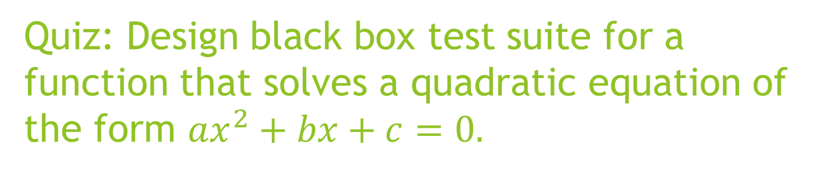
Quiz: Design black box test suite for a function that solves a quadratic equation of the form $ax^{2}+bx+c=0.$

